Slide 1
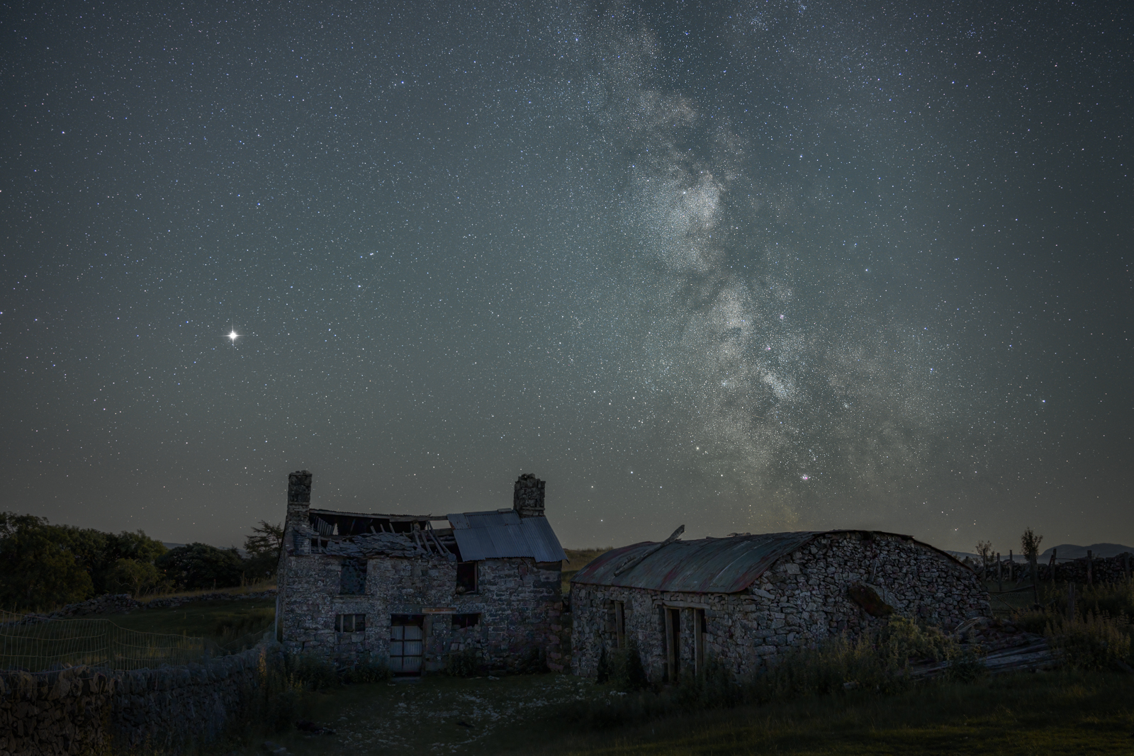
LETS TRY ASTRO PHOTOGRAPHY

Slide 2
We have all looked up and seen the night sky.
Moon shining down on us, a sky full of bright twinkling stars.
A magnificent expanse of darkness and light rising above us as far as the eye can see.
But how do we photograph it?

Slide 3
WHAT WE DON’T NEED!
Huge big expensive telescopes.
Personal Observatory, yes, you can buy ones to go in your garden.
Expensive guiding equipment.
Complicated set ups.

Slide 4
WHAT YOU WIL NEED.
Camera/memory card.
Supply of Batteries.
Wide angle lens, preferable a fast one. Or more telephoto if you want to go deeper into the night sky.
Tripod
Shutter release cable.
Warm clothing

Slide 5
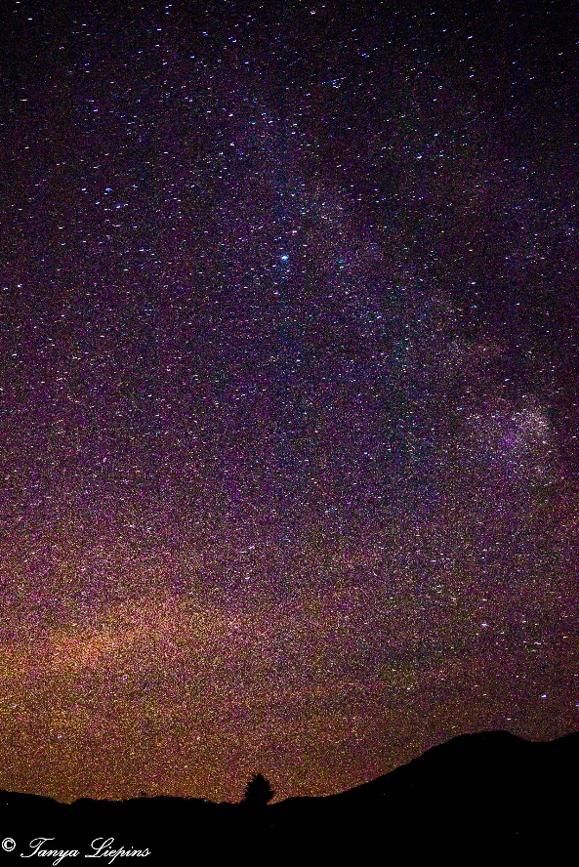
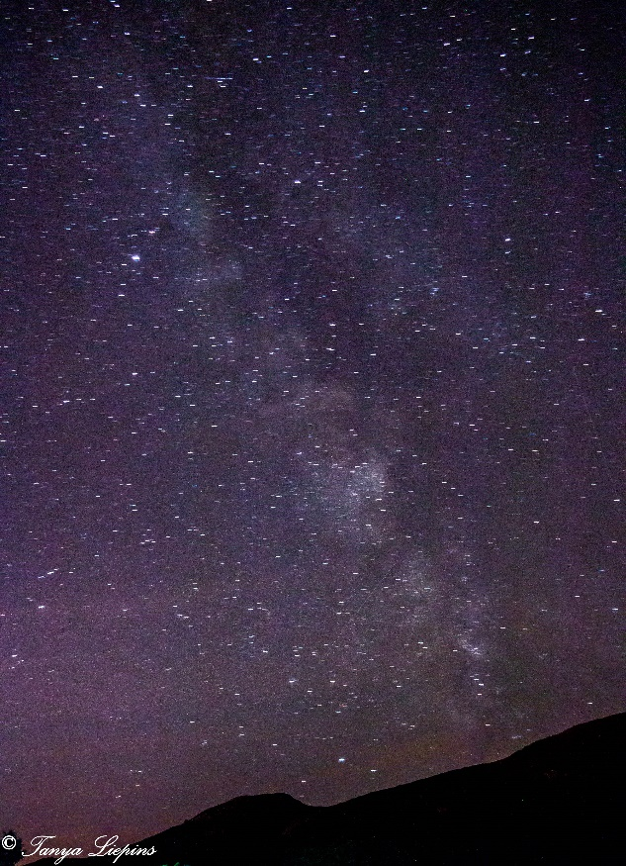
15mm F3.7. ISO 800. SS 68 seconds
15mm F3.7. ISO 800. SS 82 seconds

Slide 6
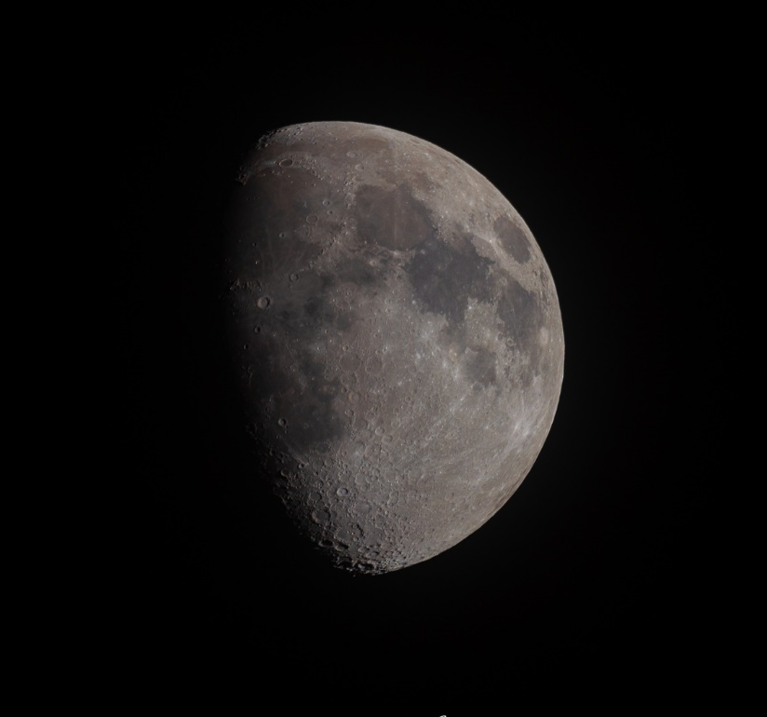
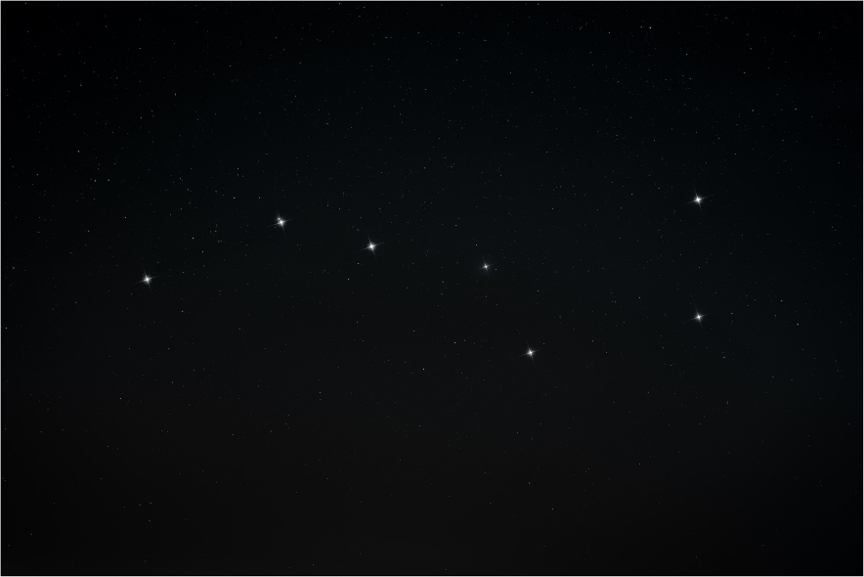
WHAT IS THERE TO PHOTOGRAPH?
Ursa Major. (Big Dipper /Plough)
35mm f2.8. ISO 6400. SS 8 Seconds
Star spikes added using “star Spikes”
600mm. F11 SS 1/125. ISO 100

Slide 7
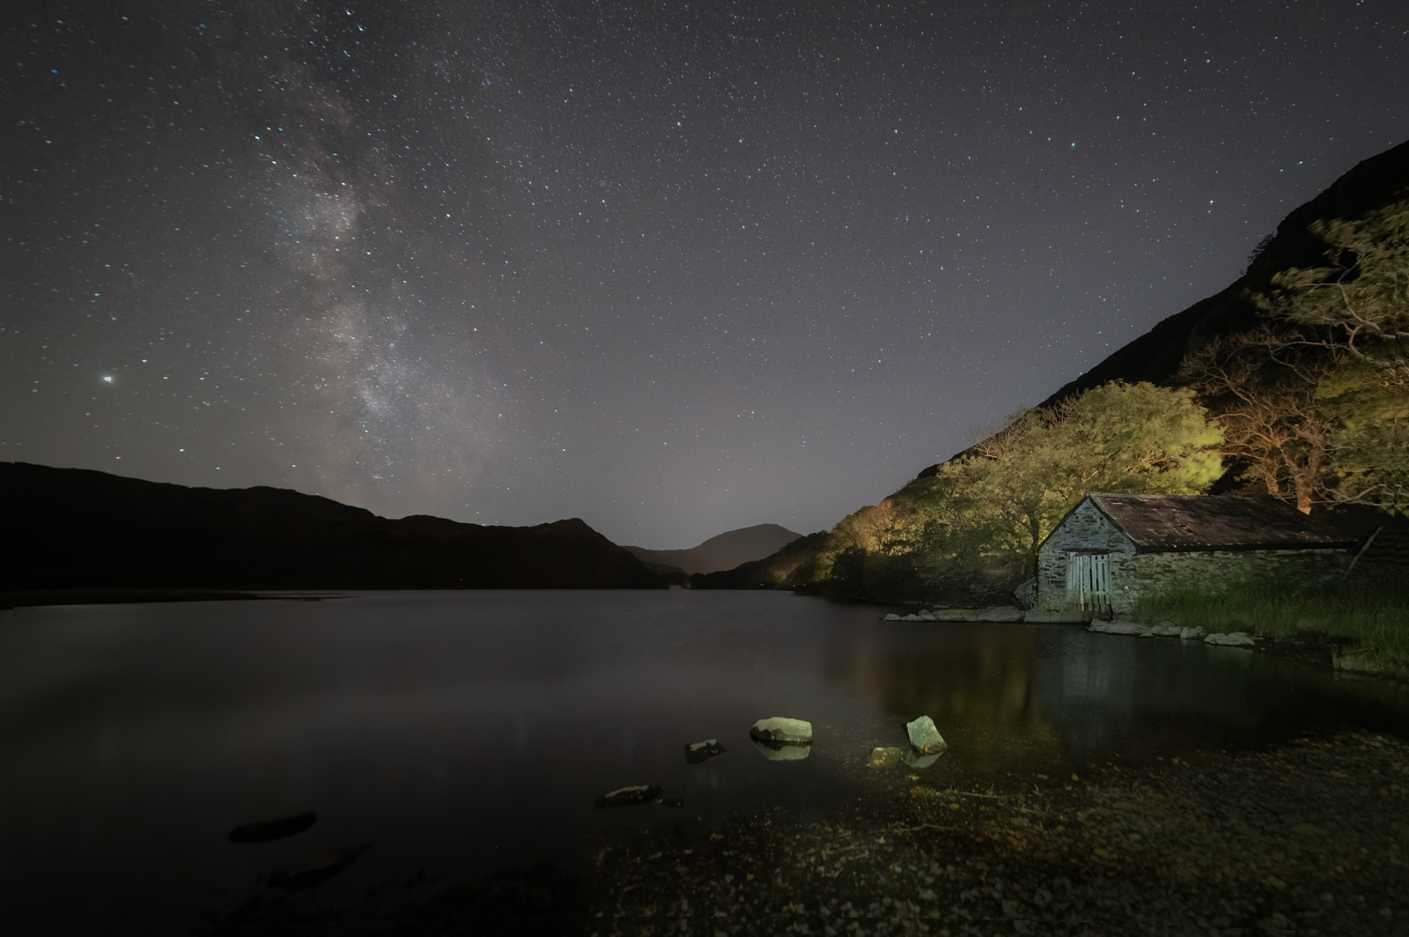

Slide 8
THE 4 P’s
PLANNING.
PATIENCE ( you will be standing around for a while)
PHOTOGRAPHING
POST EDITING

Slide 9
Planning in advance can increase your chances of success, a lot of what we try to Photograph in the night sky isn’t easily visible to the naked eye.
For Photographing the Moon you don’t really need much planning, and its pretty easy to spot. However if you want a night landscape shot, then you just need to plan if the Moon will be in the area you want it to be, and decide what focal length you want to use.

Slide 10
The Milkway, Some talk of the Milkyway season. Well it doesn’t really have a season, its there all the time. However, its positioning changes and therefore so does the visibility of the “core”. This is what leads to the term “season” being used.
But even when the core isn’t visible we can still photograph it, and its great practise for when the time comes that the core makes it appearance above the horizon again.

Slide 11
Constellations like the Plough, Orion, or Pleiades you may need to do some planning. For example Orion is only visible in our night sky in the winter months and currently rises above the horizon around 22.30hrs. As previously mentioned will they be where you want them to be in your shot?
There are many Apps that can help us with our planning and are great resources. Stellarium, Photopils, Planit pro. These show you times of the Moon rising setting, where it travels across the sky. When the Milkyway core is rising, but also many other helpful things to assist with Astrophotography.

Slide 12
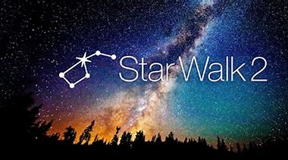
FREE
Approx £8.00 ($9.99)
Approx £8.00 ($9.99)
£2.99
$1.99

Slide 13
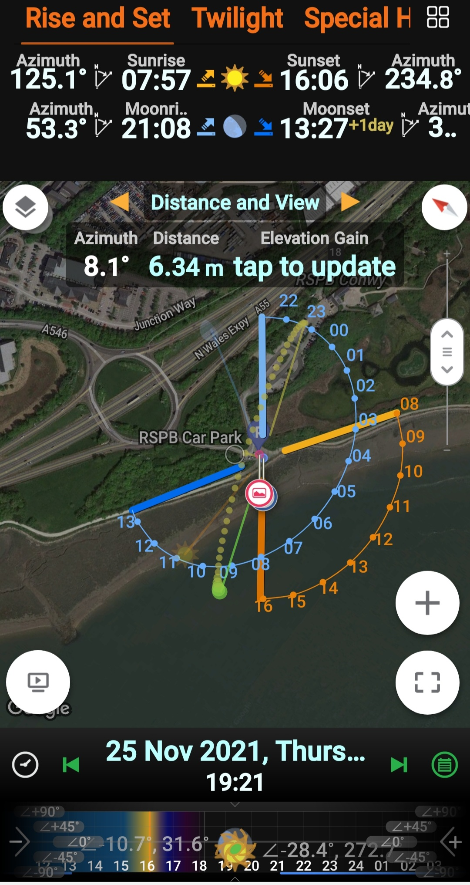
You need to consider the Moon when photographing stars and the Milkyway, as a full Moon can easily wash out so much of the detail. Plan around nights when there is no Moon, or it’s a crescent. But also check to see what time the Moon is setting or rising, as this may well give you a bigger window of opportunity. You also need to consider light pollution from nearby towns.

Slide 14
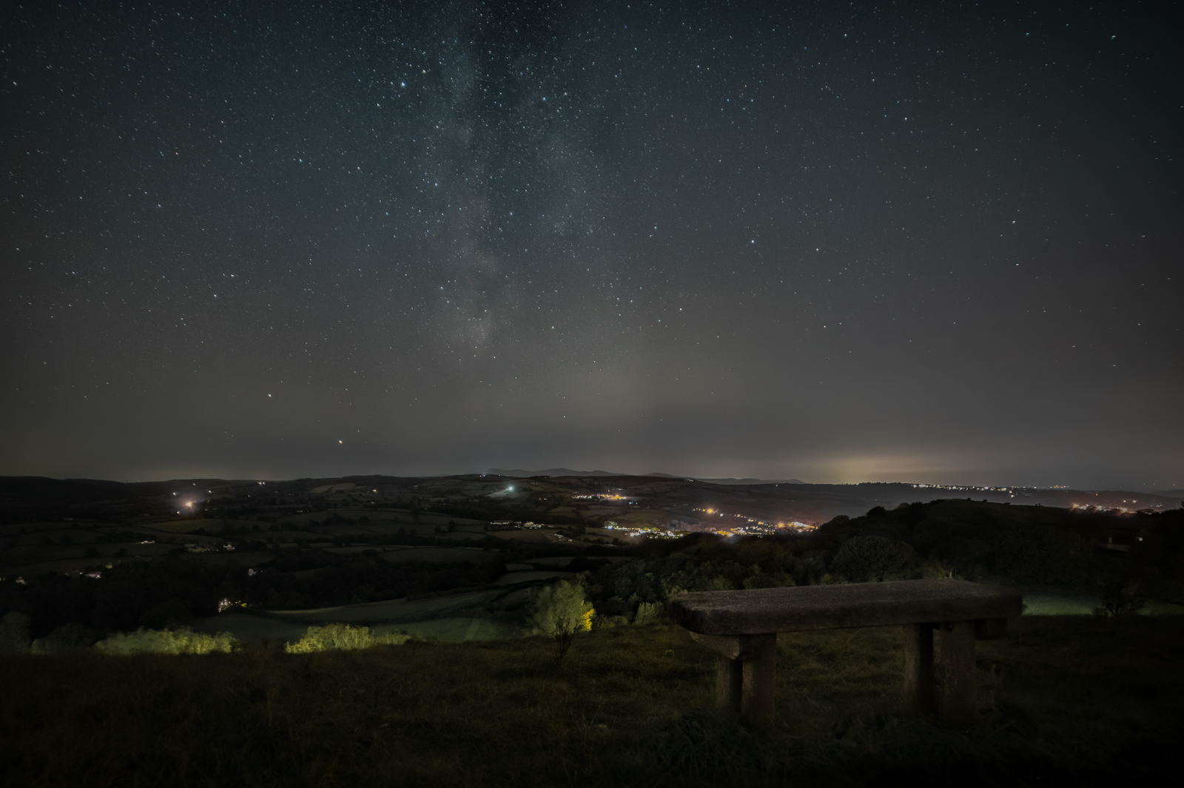

Slide 15
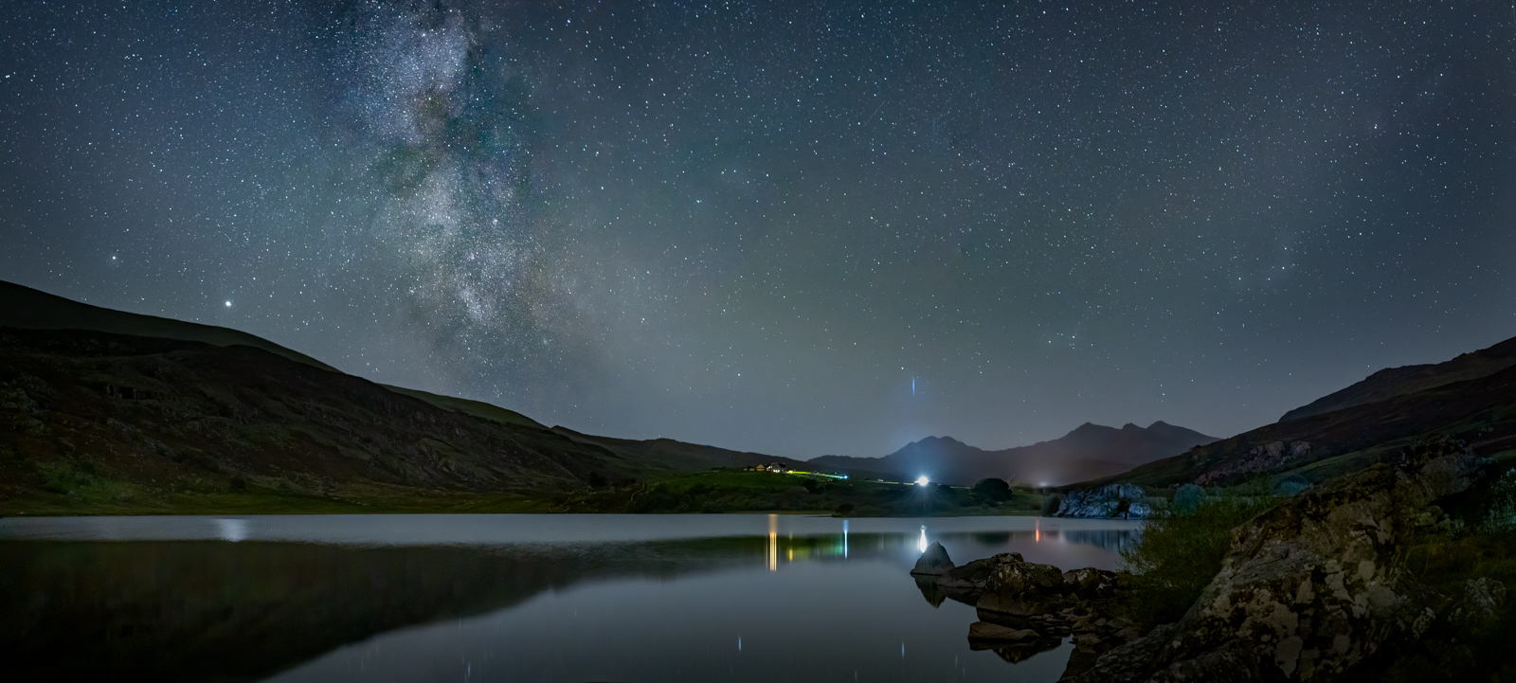

Slide 16
GETTING THE SHOT.
Always shoot in raw, you need to retain as much detail as possible.
Try and use the fastest lens you have, F1.8 – F3
Use manual focus and focus on a bright star, getting it as small as you can in your live view. Or you can enable focus peaking if your camera has it.
Work out what is the longest you can have your shutter open with your chosen lens and F stop before you start getting trailing stars. You want to keep them round! You can use the 500 rule or the more accurate NPF Rule. There is part of Photopils that works it all out for you.

Slide 17
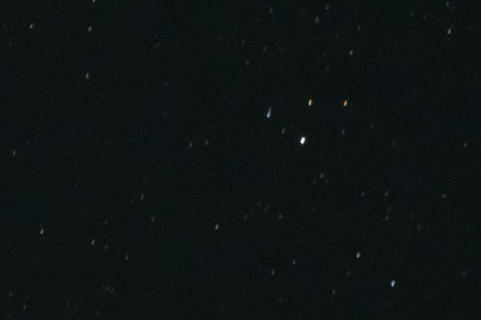
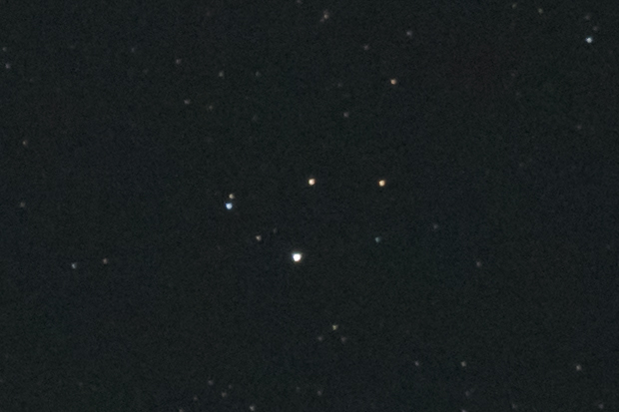

Slide 18
Don’t be afraid of Higher ISO, depending on your camera and ambient light your ISO could range from 800 to 6400 there are many ways to deal with noise nowadays.
If your shutter speed needs to be faster to prevent trailing stars you will have to increase your ISO

Slide 19
EDITING.
There are no hard or fast rules with editing and very hard to say what is right or wrong as its very Subjective, some like bold vibrant colours in their Milkyway, others don’t!
But what I have found is its more selective editing rather than global, using brushes to increase highlights, minimal dehaze to bring out detail ( but be careful it can put a lot of blue into your image.)

Slide 20
I prefer to set my White balance in camera at around 4000k
The way I learnt was YouTube, with my image open in Lightroom and then watching, pausing, doing and watching a bit more. Bit by bit you will learn your own style and what workflow works best for you. It’s a fabulous resource for learning.

Slide 21
Be warned it can become addictive! You will need to get some thermals .
You will always want better & more.
As you develop you will hear terms you don’t understand, like tracking, stacking, dark frames, bias frames.
REMEMBER ALWAYS STAY SAFE!
Reccy a location in the day, much easier to work out a preferred composition during daylight. Many apps have a Augmented reality function, so you can hold your phone up to the sky and you can see where the Milkyway or constellations will be.

Slide 22
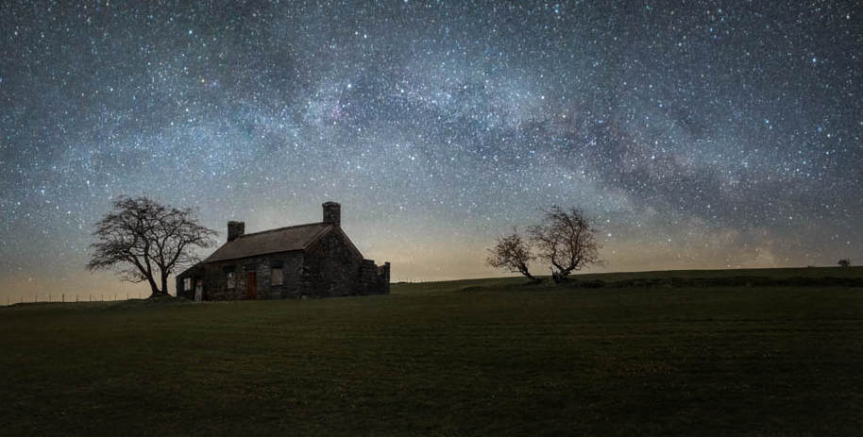

Slide 23
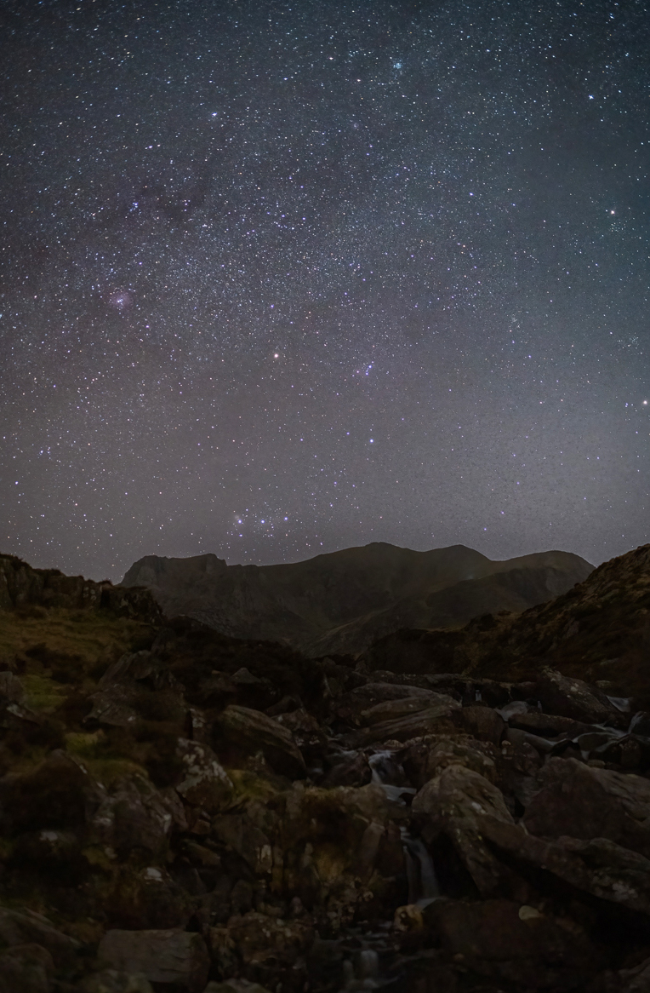
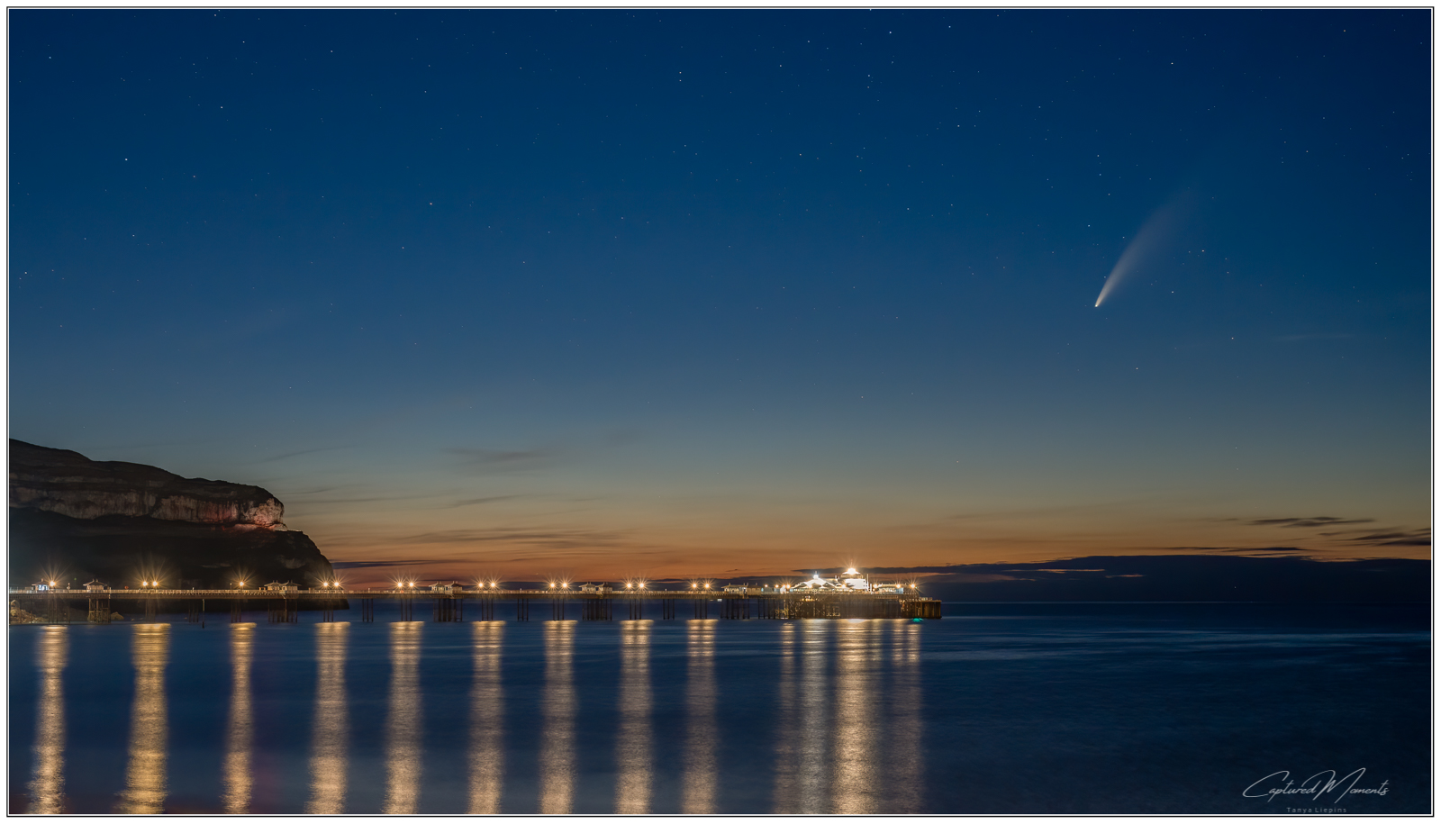

Slide 24
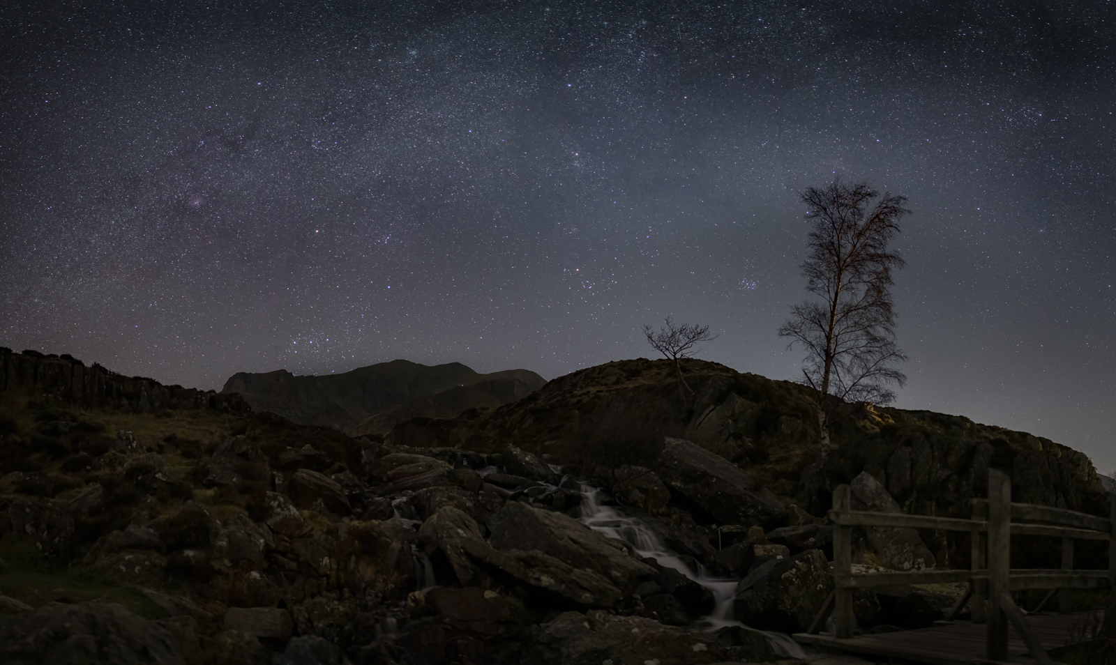
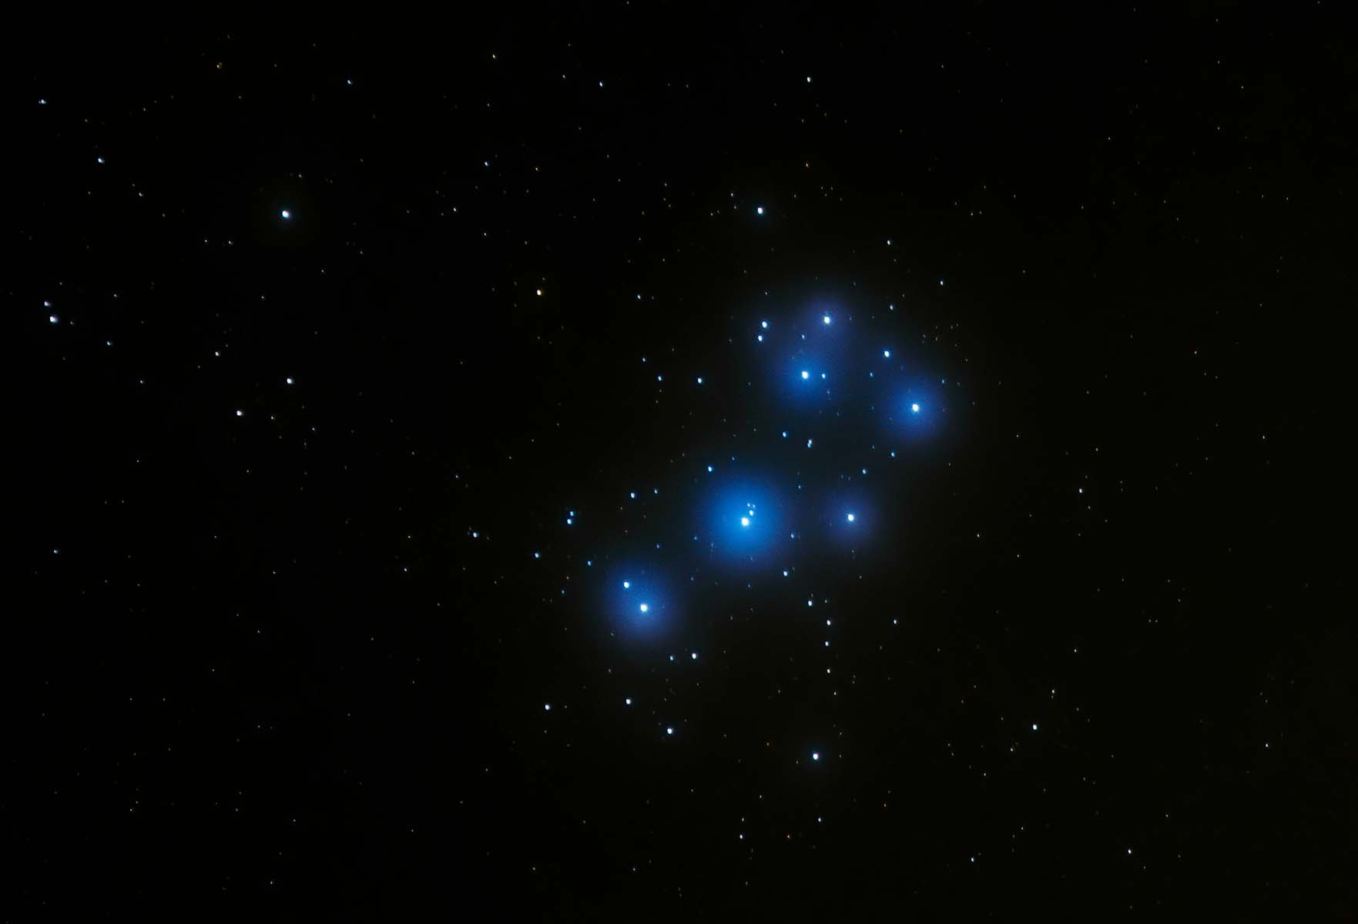

Slide 25
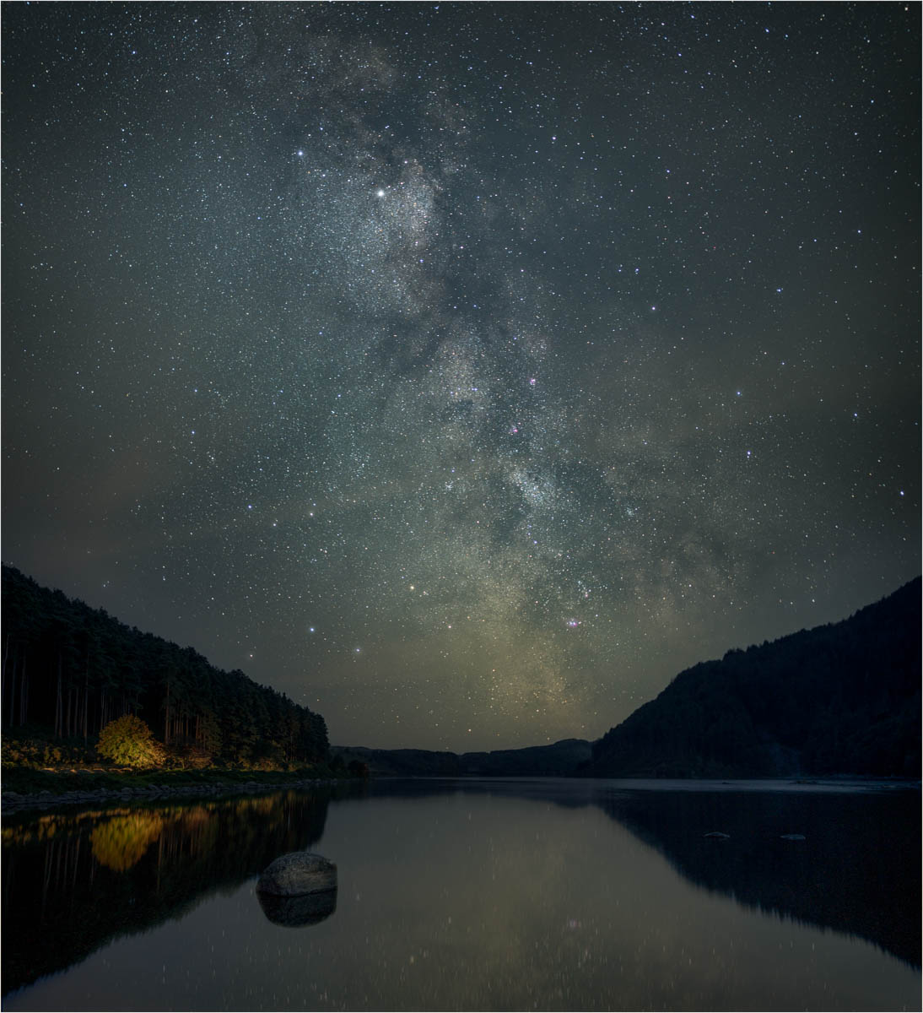

Slide 26
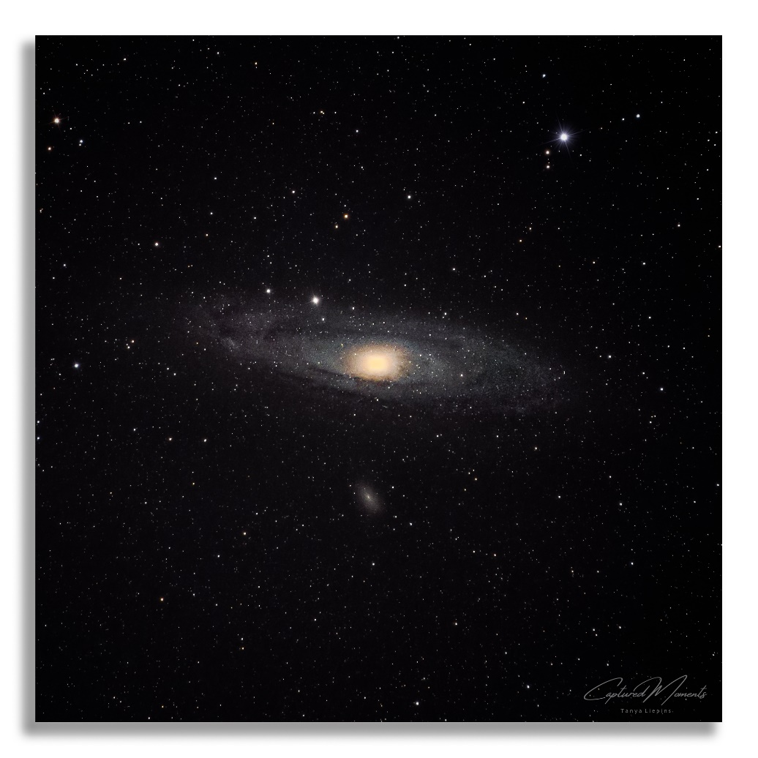
Any questions?

